Slide 1

Optimizing Search and Rescue paths in the rocky mountain region
Matthew Knodell
Lillian Makhoul
Nicholas Rogers

Slide 2

Agenda
Motivation and Background
Brief Dive Into Data Info and Cleaning
Model Types
Results
Policy Recommendations

Slide 3
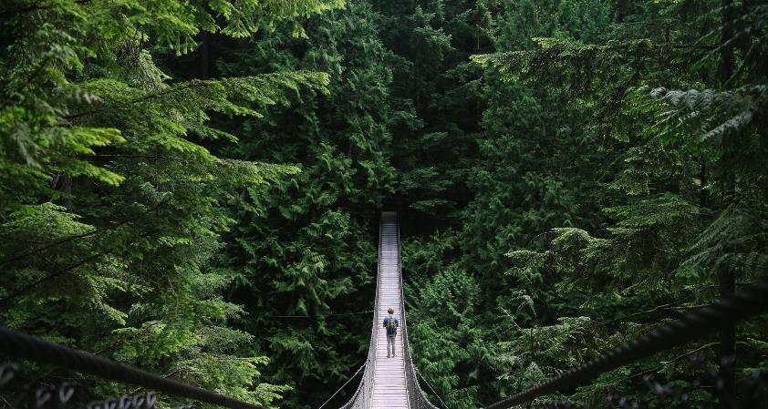

Motivation
Approx. 3000 search and rescue incidents every year with 8000 hours spent searching.
Want to make sure these hours are spent searching the most important areas.
Our goal is to optimize the paths that rescue teams take while searching for subject(s).
We consider multiple starting locations and vary the number of teams out searching.

Slide 4
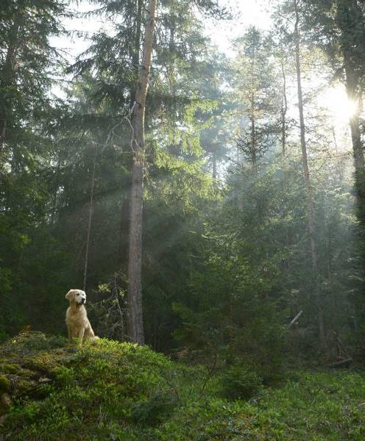
Data Information
Data acquired from Mountain Rescue Association
Information we used from the data:
X and Y coordinates of incident (latitude and longitude)
Number of subjects
4

Slide 5
Data Cleaning
Done using R
Sorted incidents by X and Y coordinates, then filtered out any that weren’t in the Rocky Mountain Region.
Determined ‘step size’, or size of each region based on length and width of Rocky Mountain region and the number of nodes we wanted.
Assigned value to nodes based on the number of subjects found at that location.
Pseudocode:
Import CSV file
Filter to only include observations with region “Rocky Mountain Region”
Filter out observations with missing information on x and y coordinates
Remove outliers
5

Slide 6
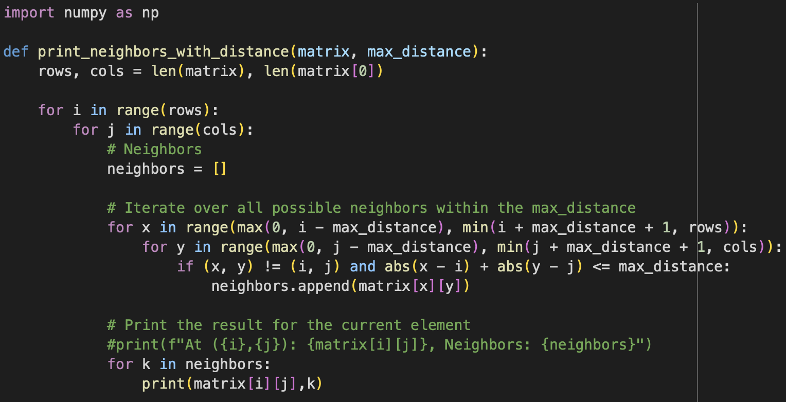
Constructing Our Data File
Value was just a list of nodes and the corresponding number of subjects found
Paths created using Python code (seen below)
Necessary to print paths for each direction; arcs/paths are not bi-directional in AMPL
6

Slide 7
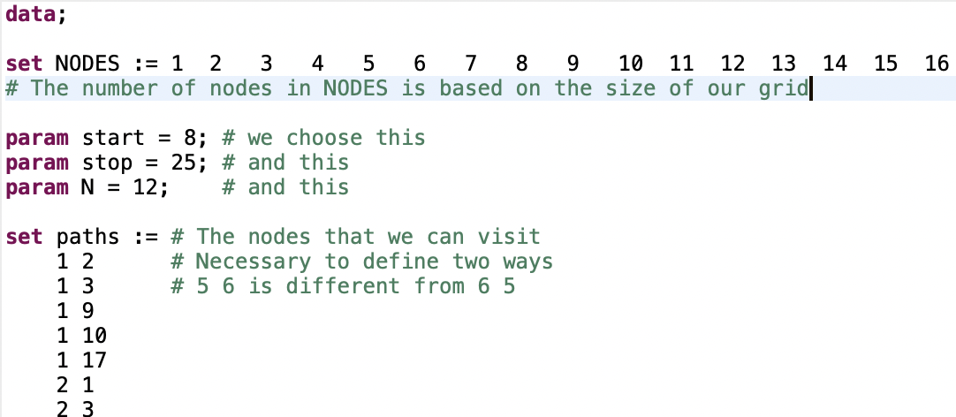
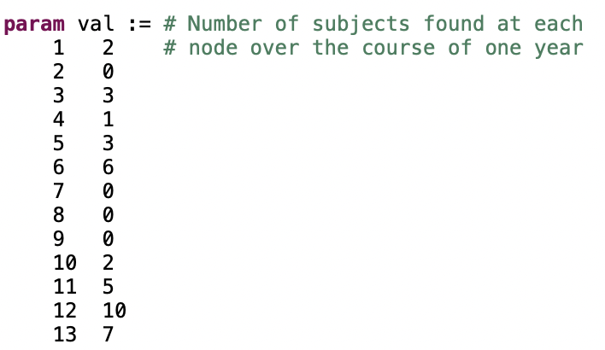
Data File
7

Slide 8
Model types: Assignment and shortest path
Assignment models are good for situations when we don’t have a strict time limit
Shortest path models allow us to add in some element of “urgency” or a restriction on how much time the rescue teams have available.

Slide 9
Why not tsp? isn’t this the perfect time for it?
Nope.
We want to be able to start and stop at points that aren’t necessarily the same.
Subtours are a convenient way to determine how many teams we need to send out.
Also, subtour elimination constraints are hard.

Slide 10
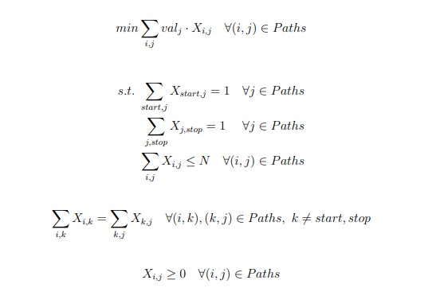
Shortest Path Model

Slide 11
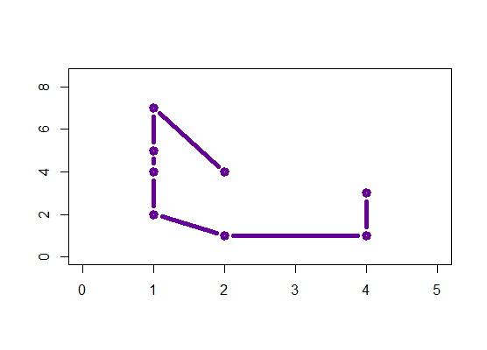
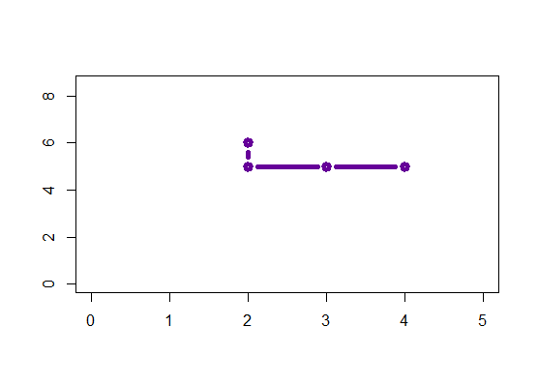

Shortest path output

Slide 12
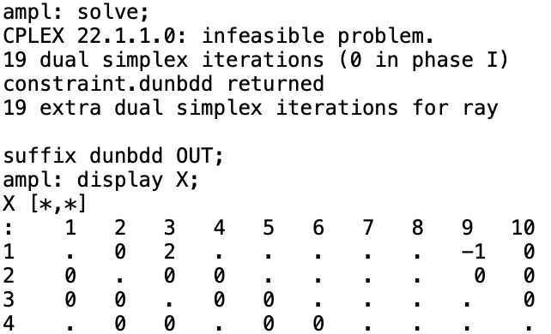
What if we give it an infeasible situation?
Surprise, it breaks.
We see negative flow going into some nodes, and flow greater than 1 going into others.
The following example uses a start of node 1 and a stop of node 50, but only allows for 2 steps.
12

Slide 13
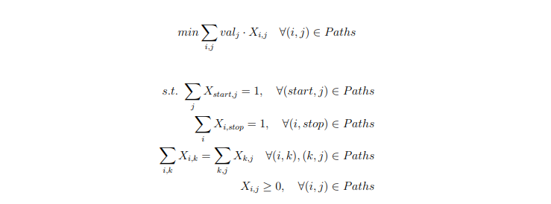
Assignment Model
13

Slide 14
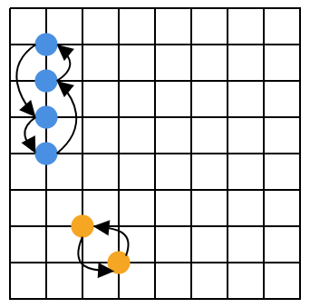
Assignment problem outputs

Slide 15
Uses and limitations
Uses
Limitations
The shortest path model is ideal for time-sensitive situations.
The assignment model is ideal for more time-flexible cases, where we want to search surrounding regions.
These paths are very general. In reality, it would vary on a case-to-case basis, specialized to the particular subject and any known history about them.
We require a start and end point for this model, which may not always be provided.
These models have no bearing on the geographic landscape, as the data available did not provide such.

Slide 16
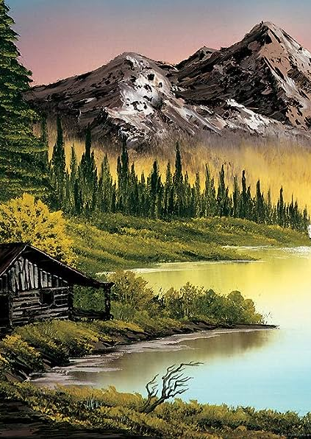
extensions
Further divide up subregions
Split cases by type of incident (e.g. swift-water rescue, medical aid, recovery)
Introduce multiple rescue teams from defined starting positions
Provide additional constraints for different “types” of teams (aircraft, ground, etc.)

Slide 17
Expanding our model to a 75x75 grid of subregions
We are now looking at 5625 regions
Each x-coordinate interval now varies by approximately 2.9 miles
Each y-coordinate interval now varies by approximately 2.8 miles
Each subregion now makes up approximately 8 square miles of the Rocky Mountain Region
Results too large to visualize

Slide 18
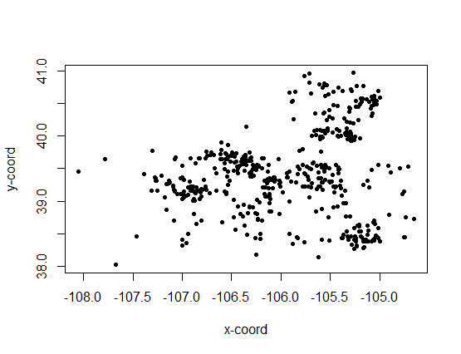
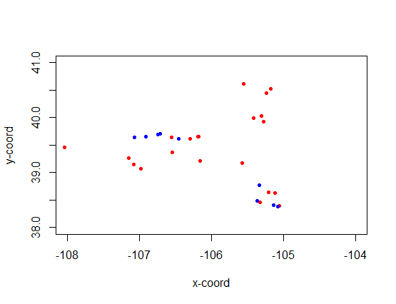
Splitting up our data by type of incident
Scatter plot of each observation, plotted based on x and y coordinated of incident
Scatter plot of observations relating to recovery incidents (red), and observations relating to swift-water rescue incidents (blue)

Slide 19



Thank you!
Matthew Knodell
Lillian Makhoul
Nicholas Rogers

